Slide 1



Maven Roasters
Sales
Report
20
23

Slide 2
Objectives
The analysis aims to uncover insights into sales trends, evaluate product performance, and understand customer purchasing behavior. The findings from this project are expected to directly influence our sales strategies, product offerings, and operational decisions.

Slide 3
Contents
01
02
Sales Overview
Sales Trends
03
04
Customer Behavior
Product Performance

Slide 4
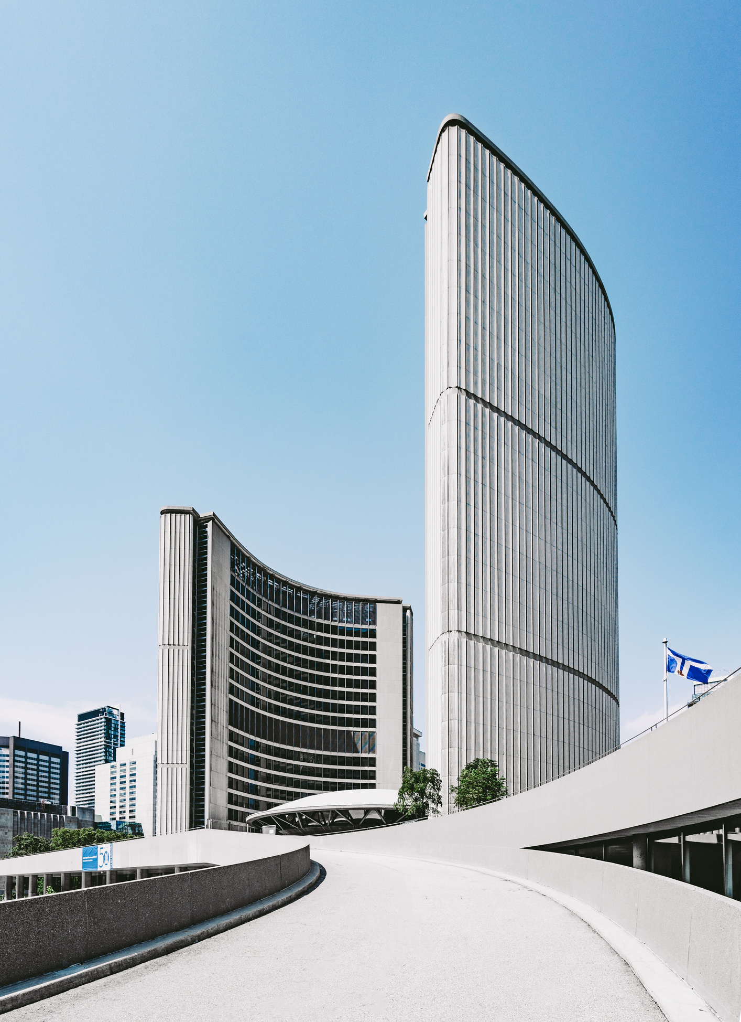

Sales Overview
In the first six months of 2023, total sales revenue from coffee shops in New York reached approximately $699K with total sales volume of 214K units. Brewed Chai Tea emerged as the best-selling product, recording 26,250 orders and accounting for a significant share of total units sold, highlighting its strong customer preference.

Slide 5
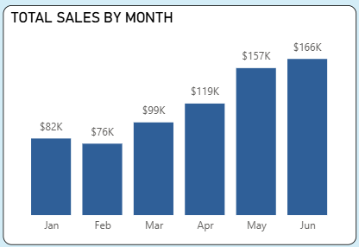

Sales Trends
From March onwards, Sales has been increasing steadily each months, from $99K in March to $166K in June.
This growth may be driven by higher coffee consumption due to warmer weather or the effectiveness of marketing campaigns.
Recommendation: Since revenue tends to rise significantly from March onward, we should strengthen marketing efforts and expand promotional programs during this period.

Slide 6
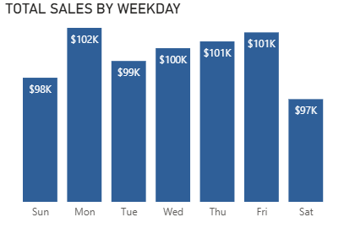
Customer Behavior
Weekday sales fluctuates between $99K and $102K, indicating a stable customer flow during working days.
The sales is slight decrease during the weekend, with Saturday and Sunday having a lowest sales. This could be due to customer engaging other activities over the weekend or the presence of other competing businesses.
Recommendation: Consider introducing weekend-specific offers or events to attract more customer and boost sales during these lower-traffic days.

Slide 7
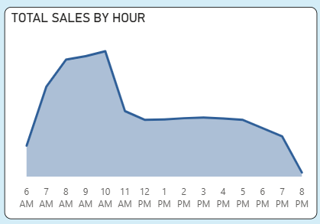
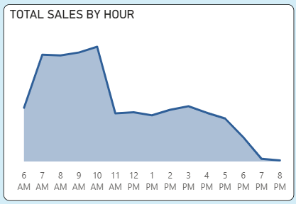
Customer Behavior
Sales tend to peak during the hours of 8 AM to 10 AM, indicating a strong breakfast and morning rush.
After 10 AM, sales drop sharply and continues to decline gradually after 12 PM.
Sales in Lower Manhattan show a significant decline after 7 PM.
Recommendations:
Given the morning rush, consider offering special promotions or new breakfast items to capitalize on this business period.
Explore strategies to increase evening sales, such as hosting events, offering discounts, or promoting evening-specific items to attract customers after typical working hours.
The store in Lower Manhattan should close early at 7 PM to optimize operating costs.

Slide 8
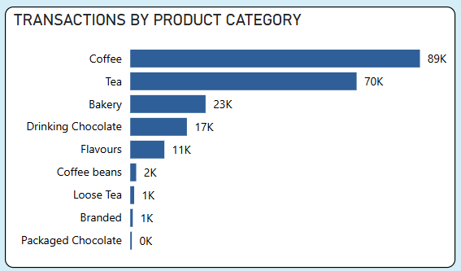
Product Performance
Coffee and Tea account for 70% of total units sold, while Bakery and Drinking Chocolate also contribute significantly to overall sales. These figures indicate substantial customer demand across categories.
Recommendations:
Expend product variety by developing new flavors and sizes in the Coffee and Tea categories to boost customer satisfaction.
Increase sales by applying cross-selling strategies to Bakery items.

Slide 9
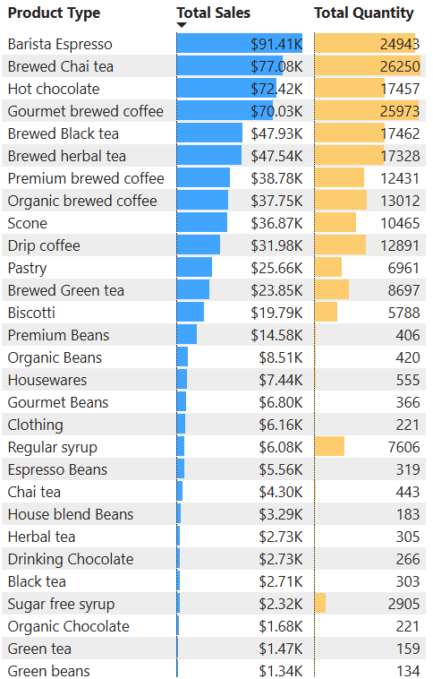
Product Performance
The top three products driving sales are Barista Espresso, Brewed Chai tea, and Hot chocolate.
Recommendation: Capitalize on the popularity of the top three products by implementing promotions or special offers to boost sales further.

Slide 10

Conclusion
Increase staffing and enhance operational efficiency during peak hours (8 AM - 10 AM).
Close the Lower Manhattan location earlier at 7 PM to reduce operational costs.
Boost sales by promoting Barista Espresso, Brewed Chai tea, and Hot chocolate.

